Slide 1
Employee Salary Prediction using Machine learning algorithm
CAPSTONE PROJECT
Presented By:
Dharini Kavya
Vels Institute of Science, Technology and Advanced Studies
B.tech CSE Artificial Intelligence and Data Science

Slide 2
OUTLINE
Problem Statement
System Development Approach (Technology Used)
Algorithm & Deployment (Step by Step Procedure)
Result
Conclusion
Future Scope
References

Slide 3
Problem Statement
In big firms, it is important to decide whether an employee is most likely to receive more than a certain salary level for planning and analytics. This project aims to make predictions based on actual employee data on whether a person takes home more than ₹50K a year. We utilize demographic and employment features such as age, education, and occupation to make these predictions. Proper classification leads to improved decision-making for HR teams. The project does not recommend salaries but provides a predictive indicator.

Slide 4
System Approach
Platform: Google Colab (model development), Hugging Face for deployment
Libraries Used: pandas, NumPy, XGBoost, scikit-learn, joblib, gradio
Interface: Built using Gradio
Deployment: Hosted permanently on Hugging Face Spaces
Model: XGBoost trained on cleaned UCI Adult dataset

Slide 5
Algorithm & Deployment
Step 1: Preprocessed the UCI Adult dataset (removed missing data, encoded categorical features)
Step 2: Performed basic EDA and added engineered features
Step 3: Trained XGBoost classifier model for binary salary classification
Step 4: Saved model using joblib
Step 5: Created Gradio interface for user input and prediction
Step 6: Deployed full app to Hugging Face at 🔗 https://dharinikavya-salary-predictor-app.hf.space

Slide 6
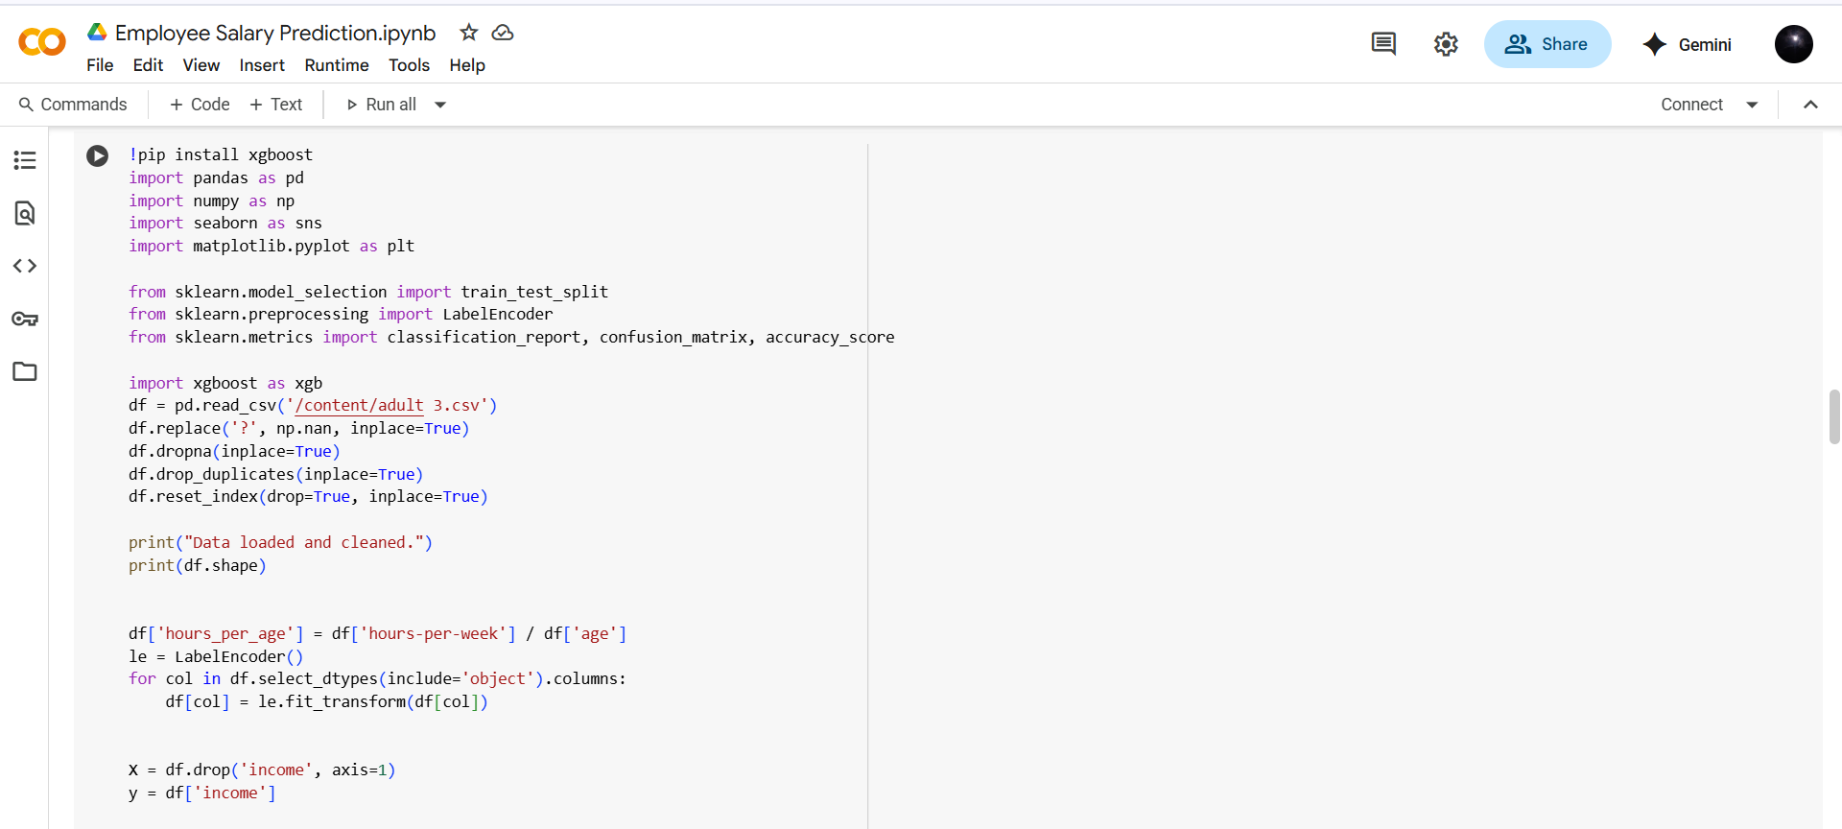
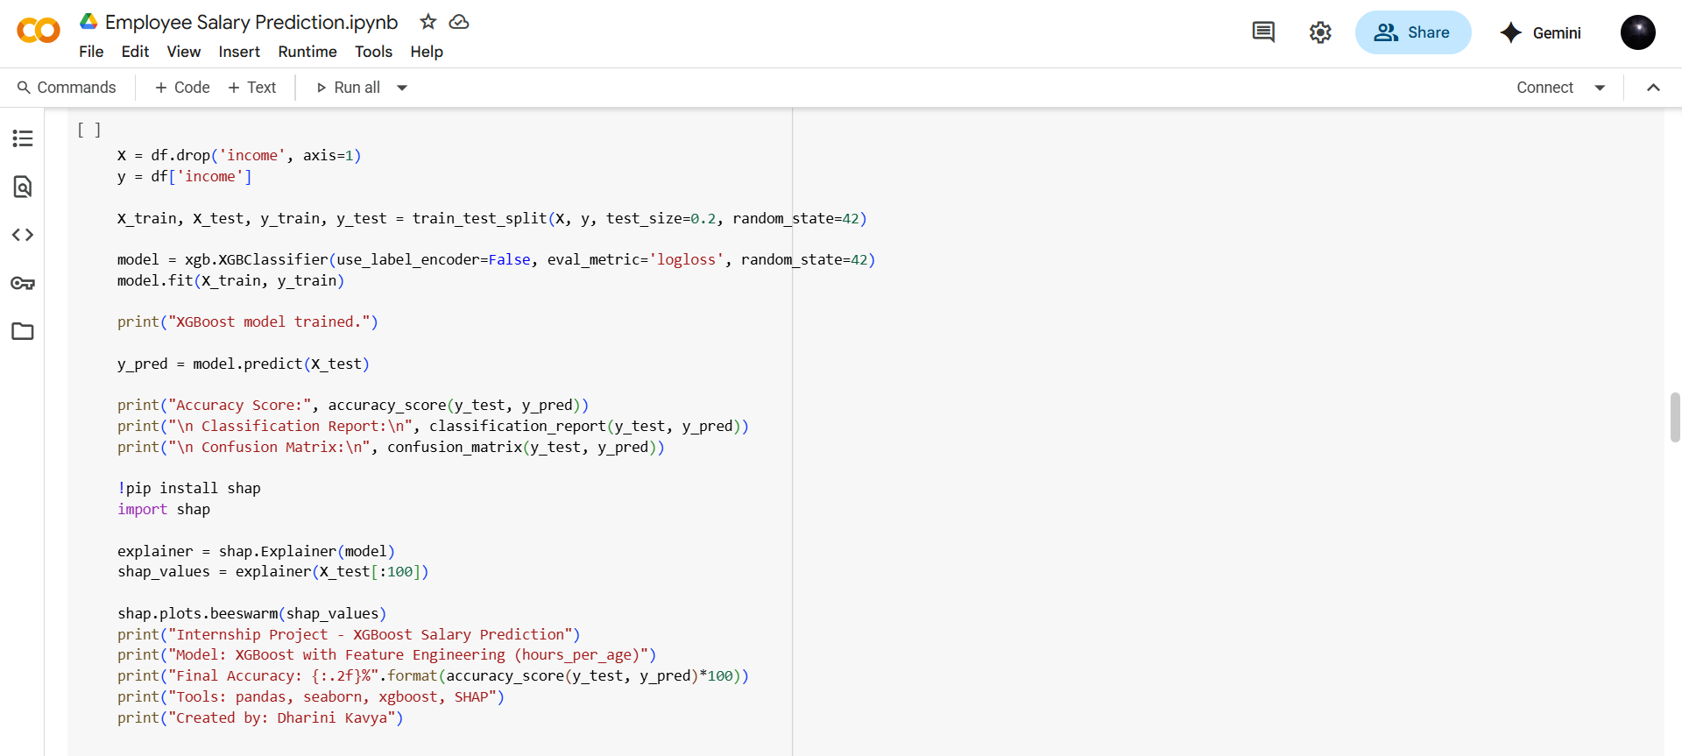
Result
GitHub Link: https://github.com/dharinikavya/salary-prediction-model.git

Slide 7
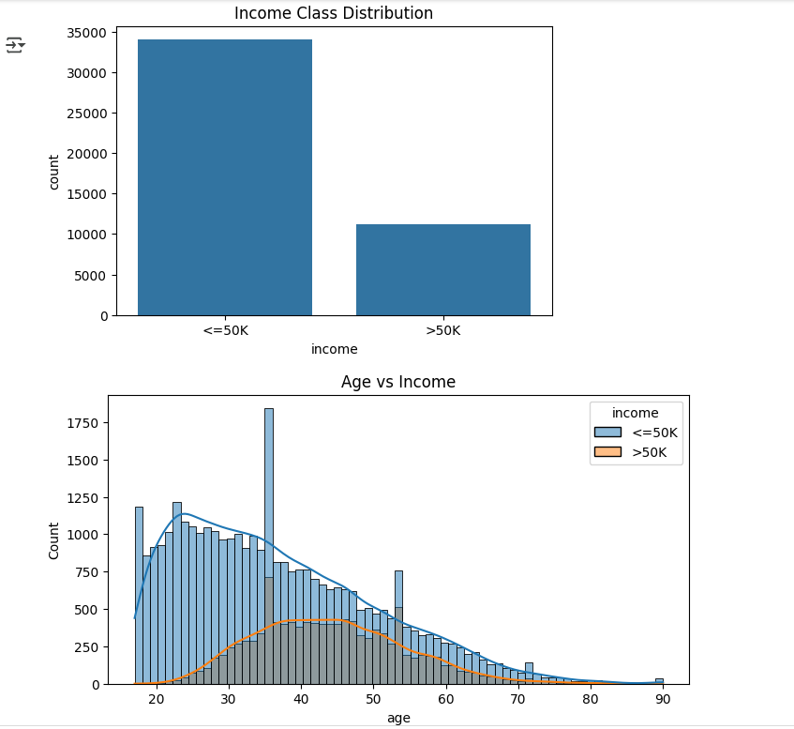
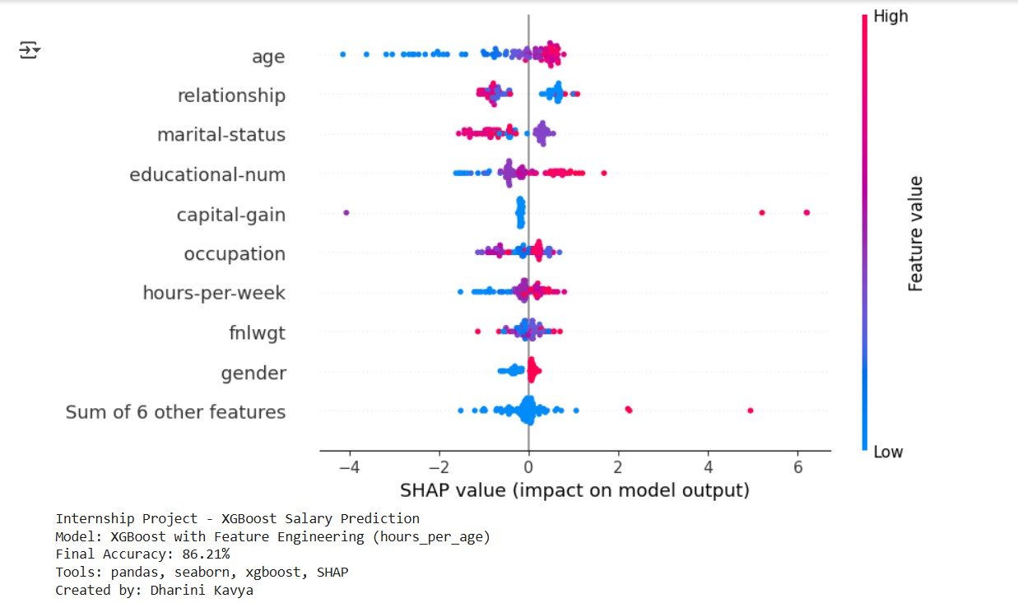
Result

Slide 8
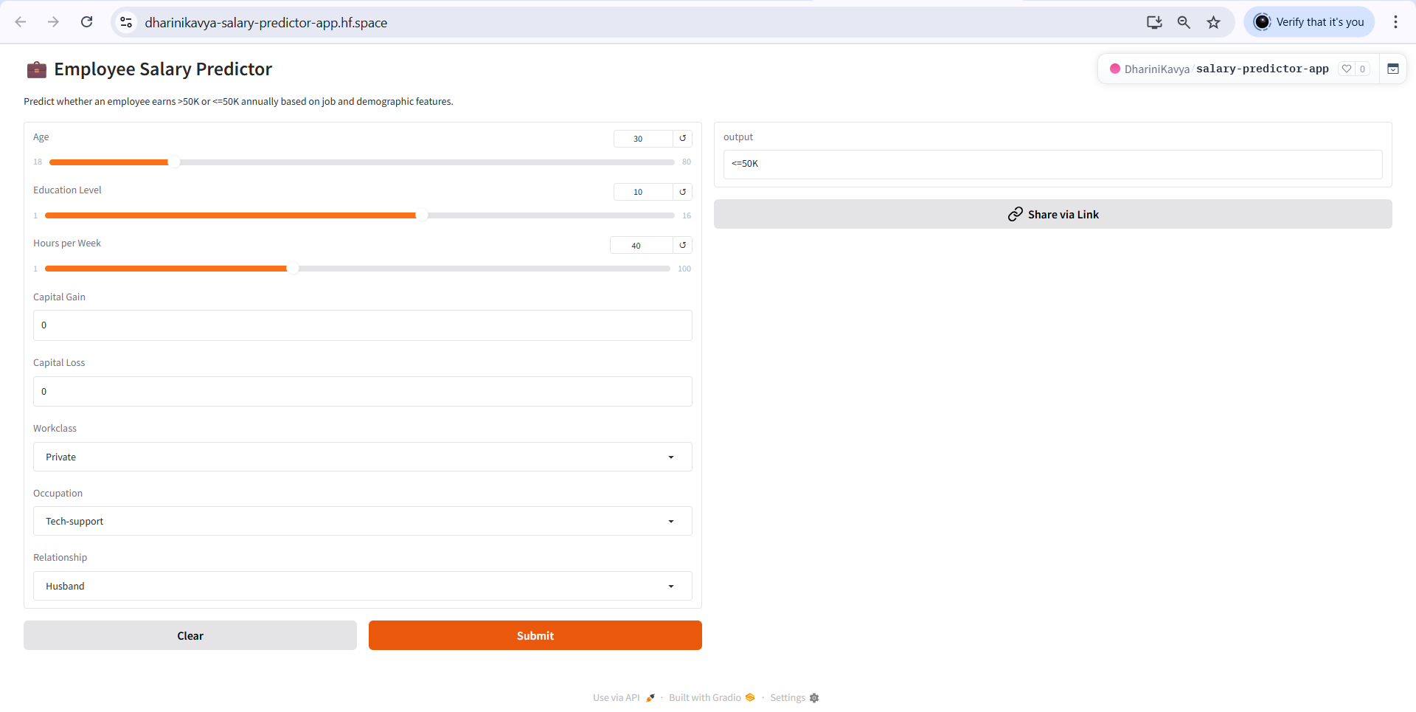
Result

Slide 9
Conclusion
This project effectively illustrates how machine learning can be utilized to predict if a person makes over ₹50K per annum given demographic and occupational factors. Through the use of the UCI Adult dataset and training a Random Forest model, we obtained precise salary classification. The Gradio usage made it possible to create an easy-to-use web interface, and Hugging Face Spaces facilitated effortless public deployment. The resulting application is interactive, responsive, and accessible on any device. The end-to-end approach mirrors actual data science processes — from data preprocessing and model training to user interface creation and deployment — making it extremely applicable for HR analytics, employee profiling, and decision support systems.

Slide 10
Future scope
Enhance Accuracy: Try advanced models like LightGBM or CatBoost
Add Features: Include job role, company size, experience, etc.
Improve Explainability: Use SHAP for model interpretation
Real-time Use: Deploy as REST API or HR dashboard integration
Mobile Access: Make the app mobile-friendly
User Feedback: Let users rate predictions for improvement

Slide 11
References
[1] Pawar L Saw A K Tomar A et al. 2022 Optimized features based machine learning model for
adult salary prediction IEEE International Conference on Data Science and Information
System pp 1-5
[2] Biswas A 2023 A Comparative Study for Salary Prediction Based on Different Models of
Machine Learning BISWAS
[3] Wang G 2022 Employee Salaries Analysis and Prediction with Machine Learning International
Conference on Machine Learning and Intelligent Systems Engineering pp 373-378
[4] Bao, Qingling. (2024). Enhancing Salary Prediction Accuracy with Advanced Machine Learning Models. Applied and Computational Engineering. 96. 149-154. 10.54254/2755-2721/96/20241185.

Slide 12
THANK YOU

